Slide 1
JavaScript
Object-Oriented Programming
Remote Scripting
xqbase.com Development Team
webmaster@xqbase.com

Slide 2
Object-Oriented Programming
Object
Class
Function
Closure
Example - Minesweeper
Q & A

Slide 3
Remote Scripting
XMLHttpRequest
Cross-Origin Resource Sharing
JSON with Padding
Image Ping
Polling
Comet
Streaming
Socket
Q & A

Slide 4
Object-Oriented Programming
Object
Class
Function
Closure
Example - Minesweeper
Q & A

Slide 5
Variable Types
Undefined var u;
Boolean var b = false;
Number var n = -0.12345;
String var s = "foo";
Function var f = function() {};
Object var o = {}; // new Object();
Null var on = null;
Array var arr = []; // new Array();

Slide 6
Define an Object
Initialize an Object
var square = {flag:0, mine:false};
Add Members
square.adjacentSquares = new Array(8);
square.setFlag = function(flag) {
square.flag = flag;
};
square.hit = function() {
square.setFlag(square.mine ? -1 : 2);
};
Usage
square.mine = true;
square.hit();

Slide 7
Object-Oriented Programming
Object
Class
Function
Closure
Example - Minesweeper
Q & A

Slide 8
Define a Class
Constructor function Square(flag, mine) {
this.flag = flag;
this.mine = mine;
// this.setFlag = function(flag) { ... };
}
Methods Square.prototype.setFlag = function(flag) { this.flag = flag;
};
Square.prototype.hit = function() {
this.setFlag(this.mine ? -1 : 2);
};
Usage var square = new Square(0, true);
square.hit();

Slide 9
Inheritance
Constructor function HiddenSquare() {
Square.call(this, -2, false);
this.hidden = true;
}
Methods HiddenSquare.prototype = new Square();
HiddenSquare.prototype.hit = function() {
alert("Unable to hit this square!");
}
Usage var hiddenSquare = new HiddenSquare();
hiddenSquare.hit();

Slide 10
Object-Oriented Programming
Object
Class
Function
Closure
Example - Minesweeper
Q & A

Slide 11
Declaration vs. Expression
Declaration
function hitSquare(square) {
square.hit();
}
Expression
var hitSquare = function(square) {
square.hit();
};

Slide 12
Block Scope
(function() {
// block code here
})();

Slide 13
Object-Oriented Programming
Object
Class
Function
Closure
Example - Minesweeper
Q & A

Slide 14
Unable to Work
for (var i = 0; i < 10; i ++) {
for (var j = 0; j < 10; j ++) {
var btn = document.createElement("input");
btn.type = "button";
btn.onclick = function() {
alert("(" + i + "," + j + ")");
};
document.body.appendChild(btn);
}
document.body.appendChild(document.createElement("br"));
}

Slide 15
Still Unable to Work ☹
for (var i = 0; i < 10; i ++) {
for (var j = 0; j < 10; j ++) {
var btn = document.createElement("input");
btn.type = "button";
var i_ = i;
var j_ = j;
btn.onclick = function() {
alert("(" + i_ + "," + j_ + ")");
};
document.body.appendChild(btn);
}
document.body.appendChild(document.createElement("br"));
}

Slide 16
Work with Closure ☺
for (var i = 0; i < 10; i ++) {
for (var j = 0; j < 10; j ++) {
var btn = document.createElement("input");
btn.type = "button";
btn.onclick = (function(i_, j_) {
return function() {
alert("(" + i_ + "," + j_ + ")");
};
})(i, j);
document.body.appendChild(btn);
}
document.body.appendChild(document.createElement("br"));
}

Slide 17
Object-Oriented Programming
Object
Class
Function
Closure
Example - Minesweeper
Q & A

Slide 18
Object-Oriented Programming
Object
Class
Function
Closure
Example - Minesweeper
Q & A

Slide 19
Remote Scripting
XMLHttpRequest
Cross-Origin Resource Sharing
JSON with Padding
Image Ping
Polling
Comet
Streaming
Socket
Q & A

Slide 20
XMLHttpRequest
function createXHR() {
if (typeof XMLHttpRequest == "undefined") {
return new ActiveXObject("MSXML2.XMLHttp");
}
return new XMLHttpRequest();
}
var xhr = createXHR();
xhr.open(...);
xhr.onload = function() {...};
xhr.onerror = function() {...};
xhr.send(...);

Slide 21
Remote Scripting
XMLHttpRequest
Cross-Origin Resource Sharing
JSON with Padding
Image Ping
Polling
Comet
Streaming
Socket
Q & A

Slide 22
Cross-Origin Resource Sharing
Request
Origin: http://www.xqbase.com/
Response
Access-Control-Allow-Origin: http://www.xqbase.com/

Slide 23
Remote Scripting
XMLHttpRequest
Cross-Origin Resource Sharing
JSON with Padding
Image Ping
Polling
Comet
Streaming
Socket
Q & A

Slide 24
JSON with Padding
function locationCallback(param) {
alert("You're at IP address " + param.ip +
", which is in " + param.city + ", " +
param.region_name);
}
var script = document.createElement("script");
script.src = "http://freegeoip.net/json/?callback=" +
"locationCallback&random=" + Math.random();
document.body.insertBefore(script,
document.body.firstChild);

Slide 25
Remote Scripting
XMLHttpRequest
Cross-Origin Resource Sharing
JSON with Padding
Image Ping
Polling
Comet
Streaming
Socket
Q & A

Slide 26
Image Ping
var img = new Image();
img.onload = function() {...};
img.onerror = function() {...};
img.src = "http://www.xqbase.com/ping";

Slide 27
Remote Scripting
XMLHttpRequest
Cross-Origin Resource Sharing
JSON with Padding
Image Ping
Polling
Comet
Streaming
Socket
Q & A

Slide 28
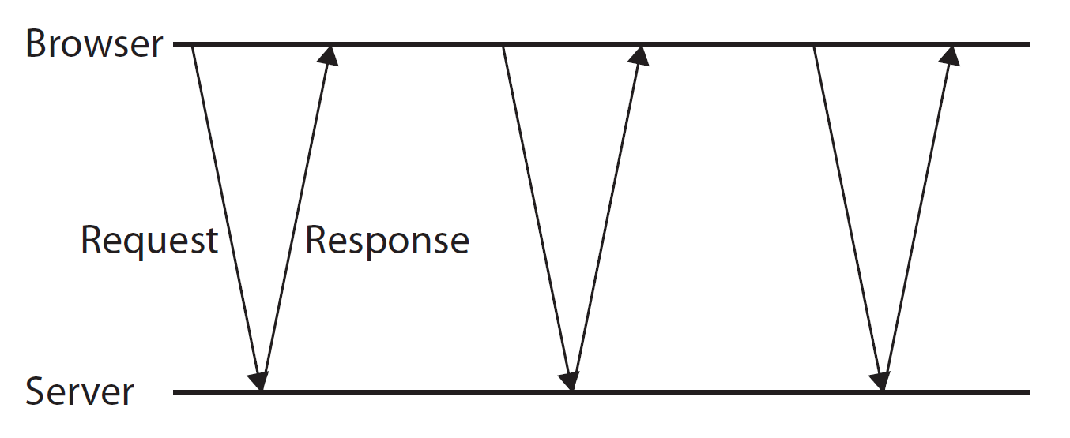
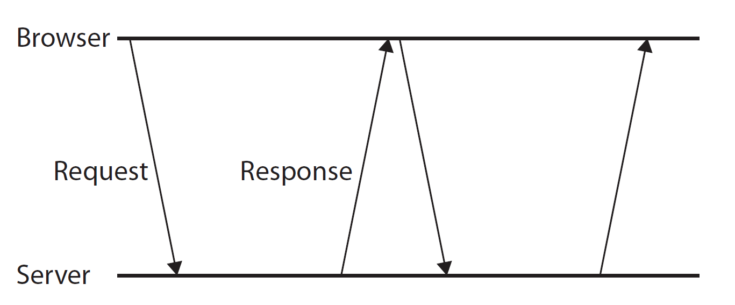
Short Polling vs. Long Polling
Short Polling
Long Polling

Slide 29
Remote Scripting
XMLHttpRequest
Cross-Origin Resource Sharing
JSON with Padding
Image Ping
Polling
Comet
Streaming
Socket
Q & A

Slide 30
Remote Scripting
XMLHttpRequest
Cross-Origin Resource Sharing
JSON with Padding
Image Ping
Polling
Comet
Streaming
Socket
Q & A

Slide 31
Remote Scripting
XMLHttpRequest
Cross-Origin Resource Sharing
JSON with Padding
Image Ping
Polling
Comet
Streaming
Socket
Q & A

Slide 32
Remote Scripting
XMLHttpRequest
Cross-Origin Resource Sharing
JSON with Padding
Image Ping
Polling
Comet
Streaming
Socket
Q & A

Slide 33
Thanks
JavaScript
Object-Oriented Programming
Remote Scripting
xqbase.com Development Team
webmaster@xqbase.com

